Slide 1
Software Engineering and Architecture
From the Trenches

Slide 2
Disclaimer
The following examples are your code.
I do not know who they belong to! I do not care!
This is not to embarrass anyone!
  You do not learn to bicycle without falling off the bike!
It is for the purpose of reflection and discussion!
  You learn a lot from seeing what others do…

Slide 3
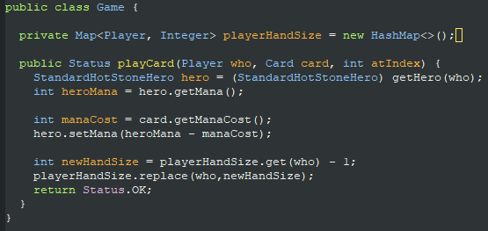
Test Ordering
TDD is about taking small steps
  But the order in which you take steps is important!
Example:
  A player’s hand is a List of cards which has a size
Handling size before list is in place is ‘lot of work for nothing’
Notes:
Morale: TDD’ing the proper handling of hand size before the List<Card> hand is in place is like ‘gå over åen efter vand’

Slide 4
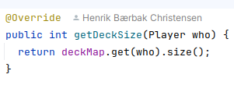
Comparison
My implementation looks like this
… because I knew that the TDD of the size of hand/deck will automatically be implemented once the hand/deck lists were correctly TDD’ed in place…
… because ‘lookup in Hashmap’ is better than switches

Slide 5
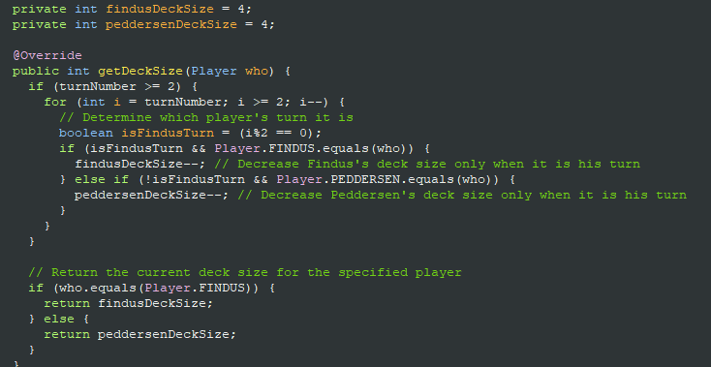
And this one…
Large is not beautiful in software development…
Compare complexity to:

Slide 6
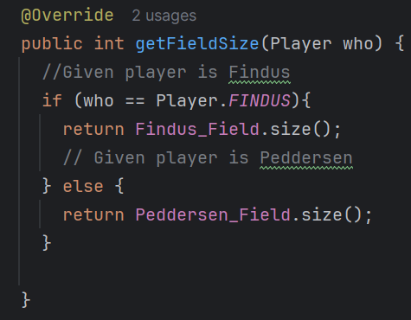
Use your Data structures
What can be constructively criticized here?
Use a datastructure that can lookup
the list
Notes:
Use lookups instead

Slide 7
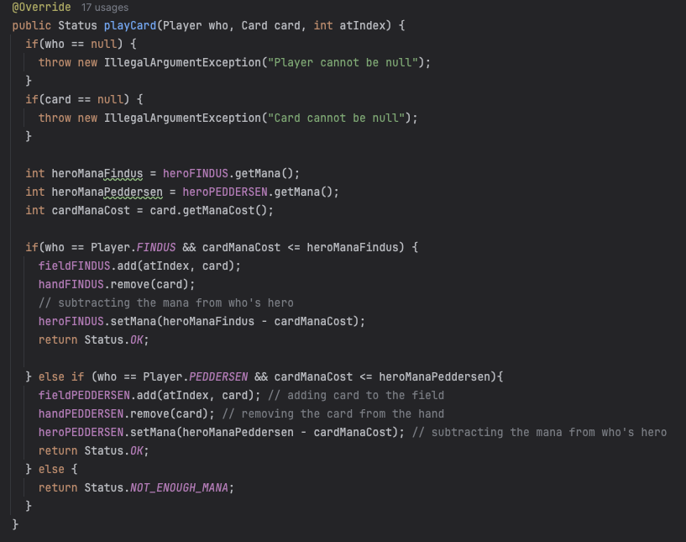
Use Data structures
Why switch on
the player?
Why not look
it up?

Slide 8
TDD of ‘getHand()’
getHand() returns an Iterable<Card> to allow clients to easily iterate cards ala
  for (Card c : game.getHand()) { … do something with c; }
The UI will use that all the time!
But I guess you already have testet ‘getCardInHand(..)’?
Then TDD of getHand() is simple
  Call it and ensure it returns something…

Slide 9
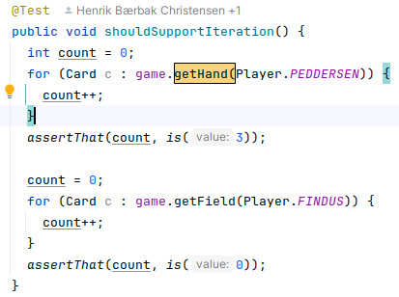
My single test case
Is more or less just a call…
  TDD is a ‘programming technique’ …
  … not a ‘comprehensive
  testing technique’
  We will return to
  systematic testing
  later

Slide 10
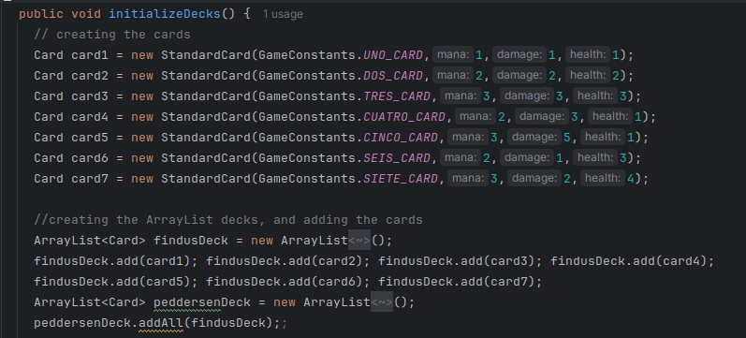
Objects = Unique Identity
Cards represent physical objects
  Two Uno cards are --- well – two Uno cards!
What is wrong here?

Slide 11
To see it
What happens when Peddersen attacks Findus’ Tres Card?
Exercise:
  If you not understand the problem, you should stay on this page until you do understand, or you will never become good at programming ☺

Slide 12
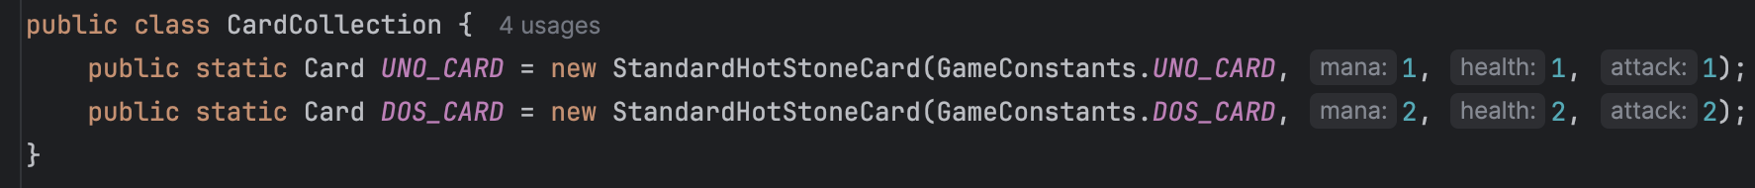
Another example
A similar issue
  The idea of a CardCollection is fine, but this is not the way to do it.
What is the issue here:

Slide 13
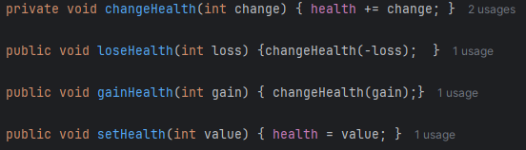
Over-methodication ☺
Do not pollute the method space
  Discussed at the Kata…

Slide 14
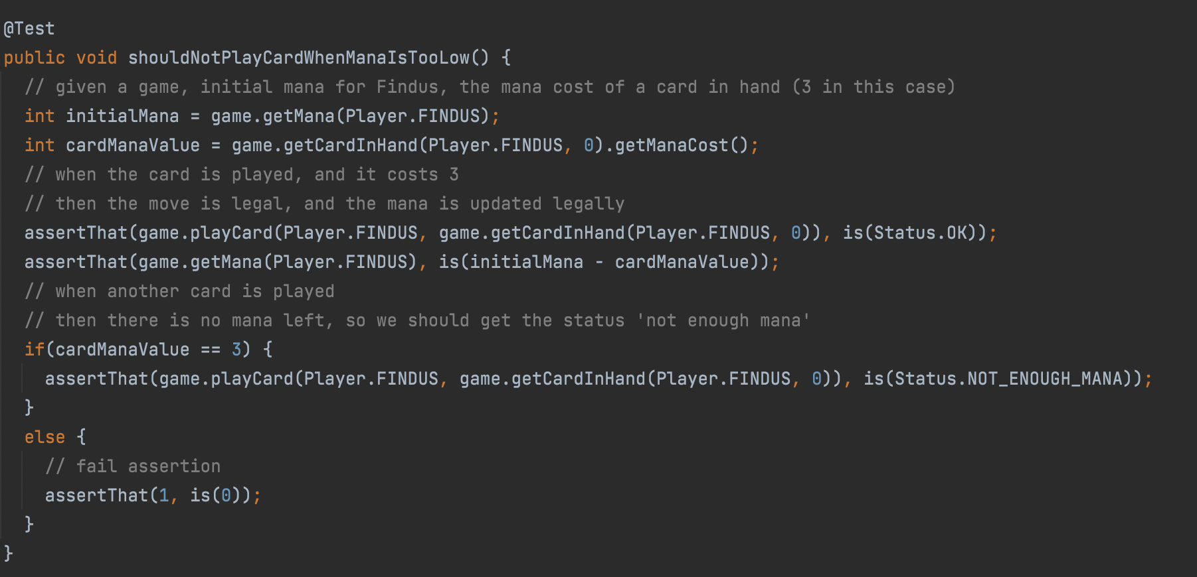
Constructive Critique?
Notes:
Not evident as computations made; not evident as an If; Not evident as test cases are CONCRETE – use the numbers! How many times is game.getCardInHand

Slide 15
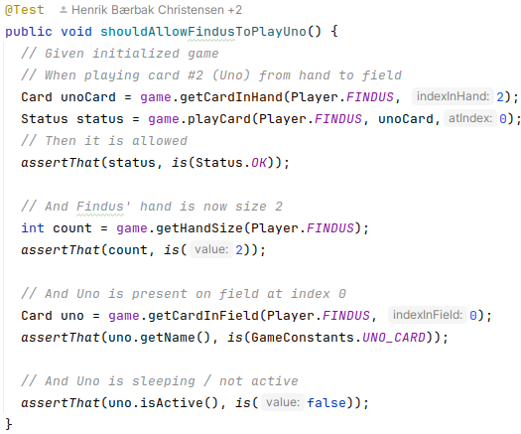
From My Own TDD
Note:
  Concrete values
  [Testcases are
  concrete!]
  Use names for
  cards to make
  test evident
  No ifs! Ever!
Evident Tests
Notes:
Not evident as computations made; not evident as an If; Not evident as test cases are CONCRETE – use the numbers! How many times is game.getCardInHand called?

Slide 16
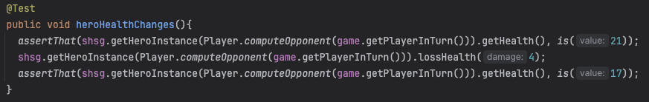
Evident Tests
Evident = easy to understand fast…
Is this evident?

Slide 17
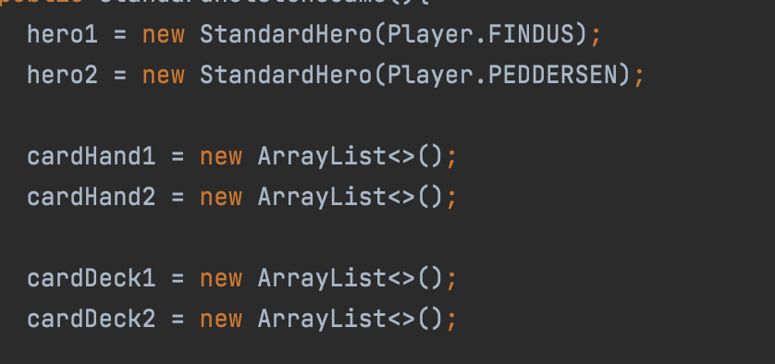
Meaningful Names
Use names that say what they are
  Why is findus’ hero – not called ‘findusHero’?

